Slide 1
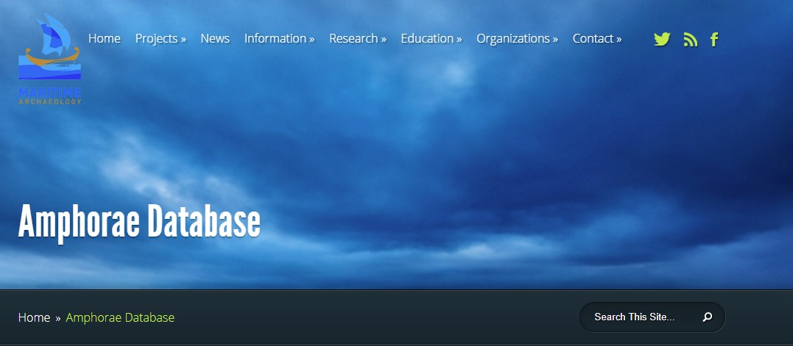
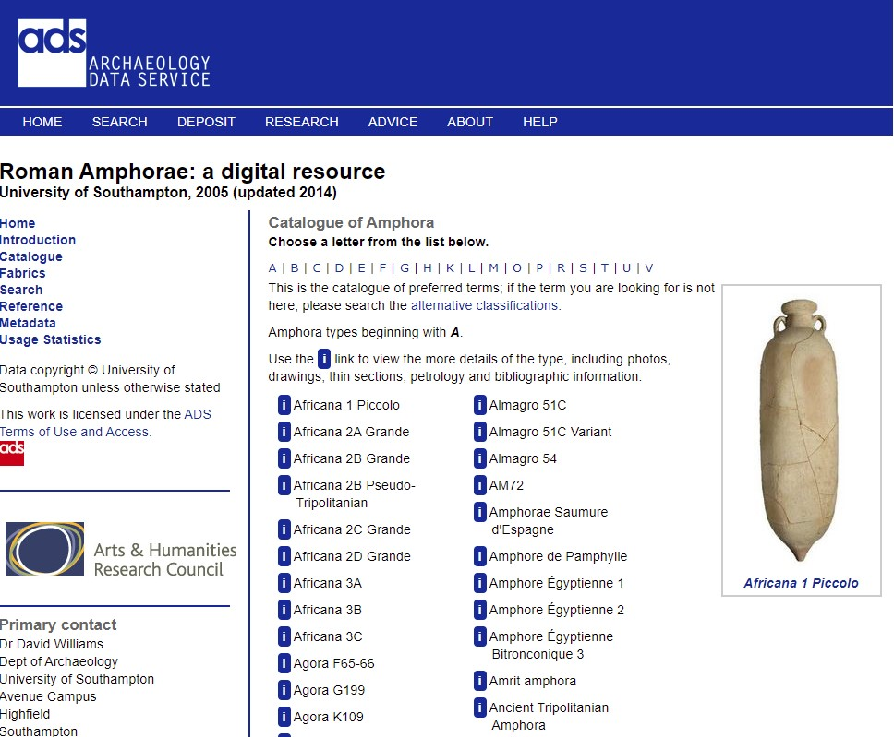
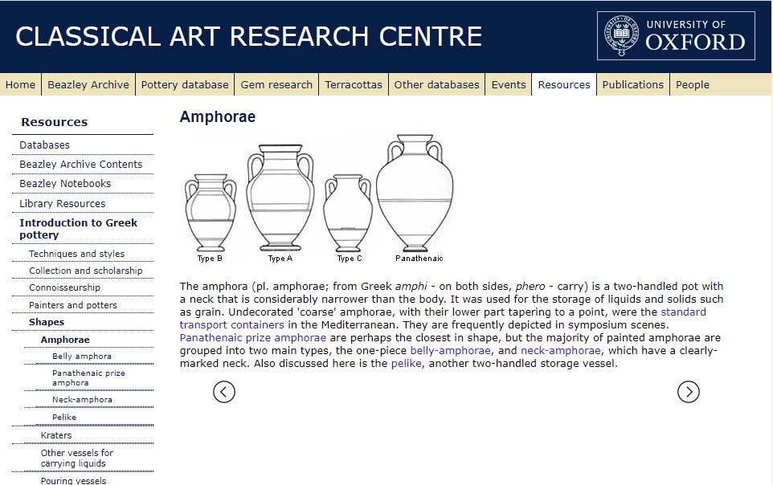
ERC – Datasets
Amphorae
http://www.maritimearchaeology.com/information/reference/amphorae/
Needs to be linked to some database online…
https://www.beazley.ox.ac.uk/tools/pottery/shapes/amphorae.htm
https://archaeologydataservice.ac.uk/archives/view/amphora_ahrb_2005/cat_amph.cfm

Slide 2
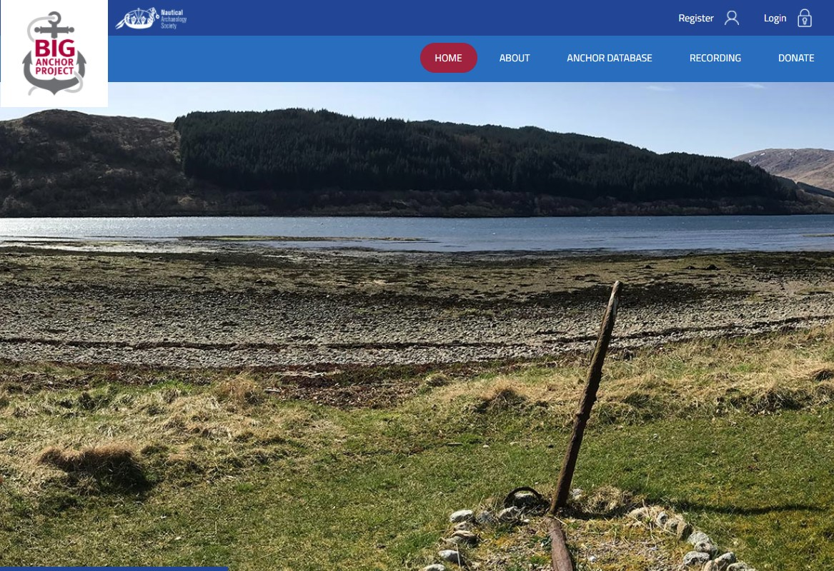
ERC – Datasets
Anchors
https://biganchorproject.com/
Needs to be linked to some database online…

Slide 3
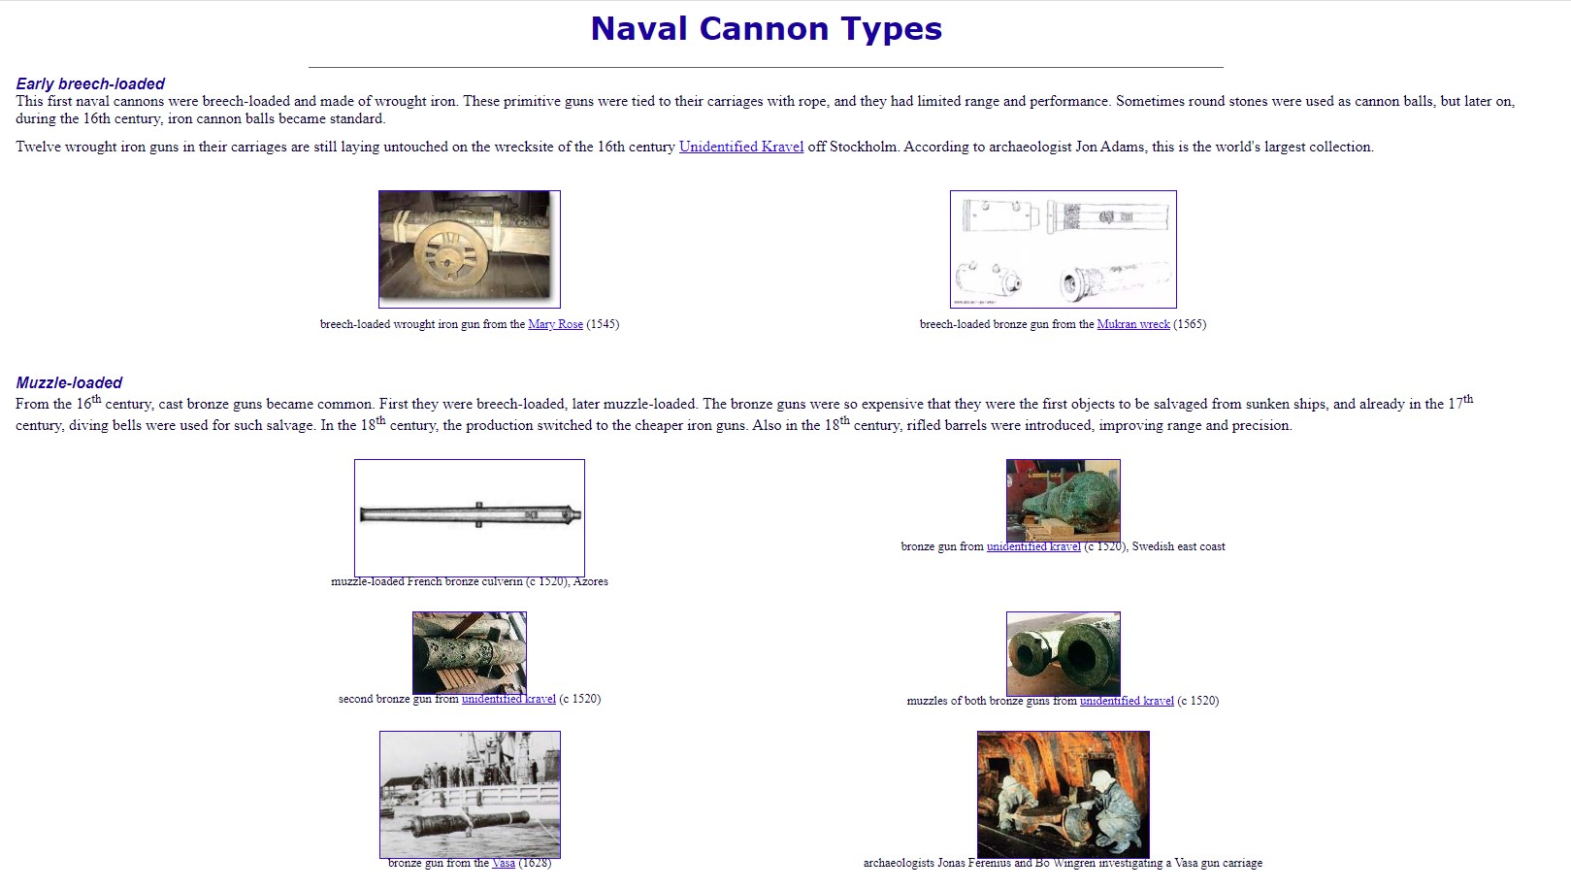
ERC – Datasets
Guns
Needs to be linked to some database online…
I have a lot of inventories
https://www.abc.se/~pa/bld/cannon.htm

Slide 4
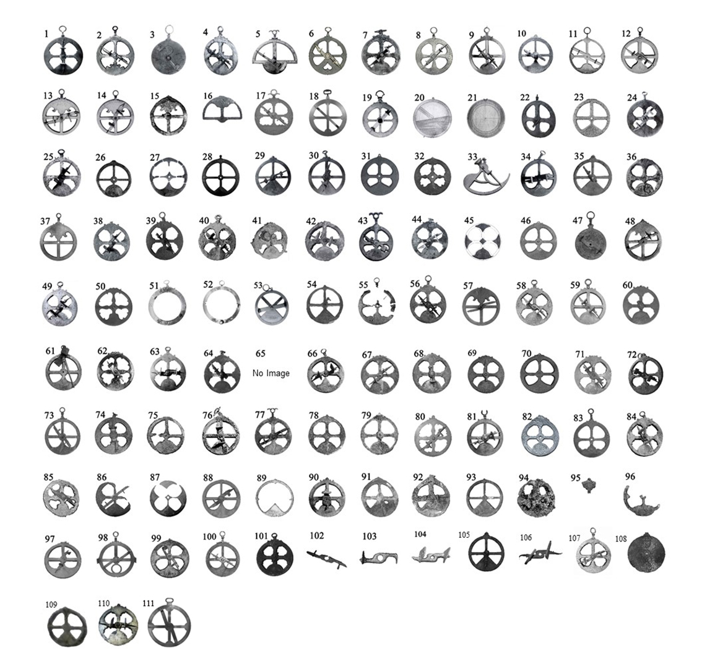
ERC – Datasets
Astrolabes
Images
Table

Slide 5
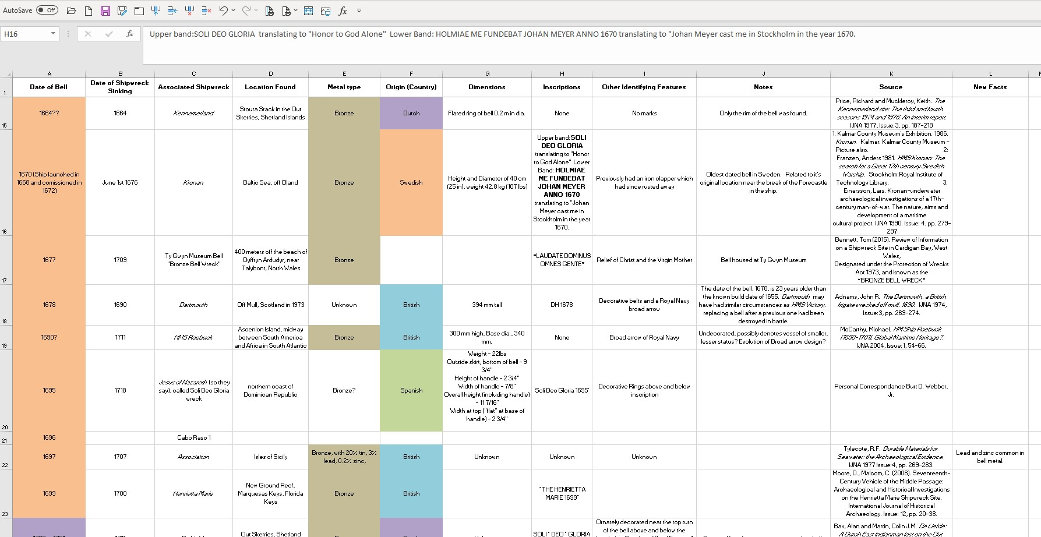
ERC – Datasets
Bells
Images
Table – Needs to be cleaned

Slide 6
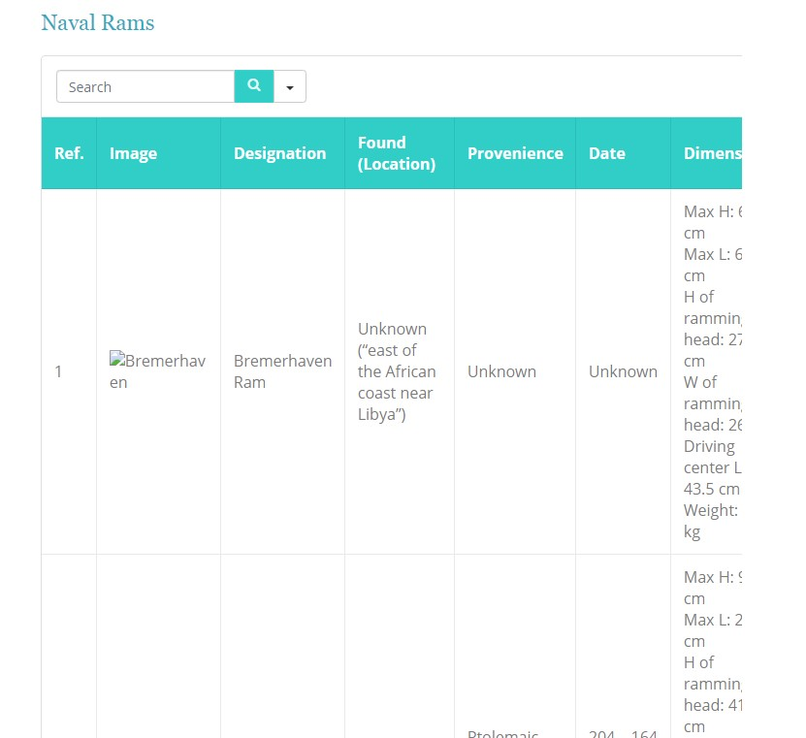
ERC – Datasets
Rams
Images – need to get them from NADL
Table – Need to get it from NADL

Slide 7
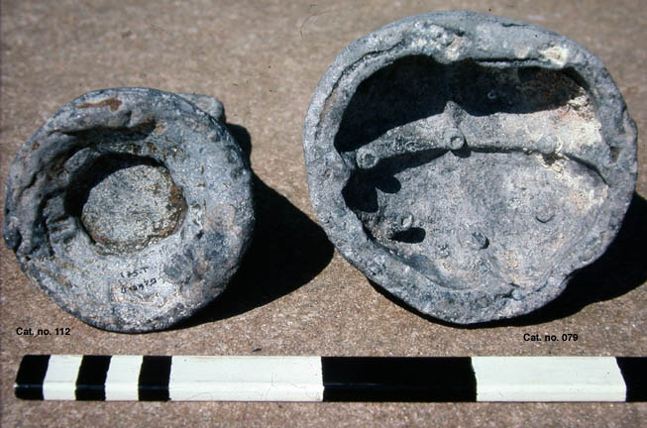
ERC – Datasets
Sounding Leads
Images – need to get them from literature
Table – Need to make it
E. Galili, J.P. Oleson, B. Rosen, "A Group of Exceptionally Heavy Ancient Sounding Leads: New Data Cponcerning Deep-Water Navigation in the Roman Mediterranean," Mariner's Mirror 96 (2010) 136-48.
J.P. Oleson, "Ancient Lead Circles and Sounding-Leads from Israeli Coastal Waters," Sefunim: Bulletin of the National Maritime Museum of Israel 7 (1988) 27-40.
J.P. Oleson, "An Ancient Lead Sounding-Weight in the National Maritime Museum," Sefunim: Bulletin of the National Maritime Museum of Israel 8 (1994) 29-34.
J.P. Oleson, "Herodotus, Mark Twain and Early Navigation," Resolution, Journal of the Maritime Museum of British Columbia 38 (Summer 1996) 19-20.J.P. Oleson, "Ancient Sounding-weights: a contribution to the history of Mediterranean navigation," Journal of Roman Archaeology 13 (2000) 293-310.
J.P. Oleson “Herodotus, Aristotle, and Sounding Weights: The Deep Sea as a Frontier in the Classical World,” pp. 32-48 in T. P. Tassios, C. Palyvou (edd.), Ancient Greek Technology: Proceedings of the 2nd International Congress. Athens: Technical Chamber of Greece, 2006.
J.P. Oleson, “Testing the Waters: The Role of Sounding-Weights in Ancient Mediterranean Navigation.” Pp. 119-76 in R.L. Hohlfelder, ed., The Maritime World of Ancient Rome. Memoirs of the American Academy in Rome, Suppl. 6. Ann Arbor: University of Michigan Press, 2008.
https://web.uvic.ca/~jpoleson/Sounding%20weights/SL%20intro.html

Slide 8
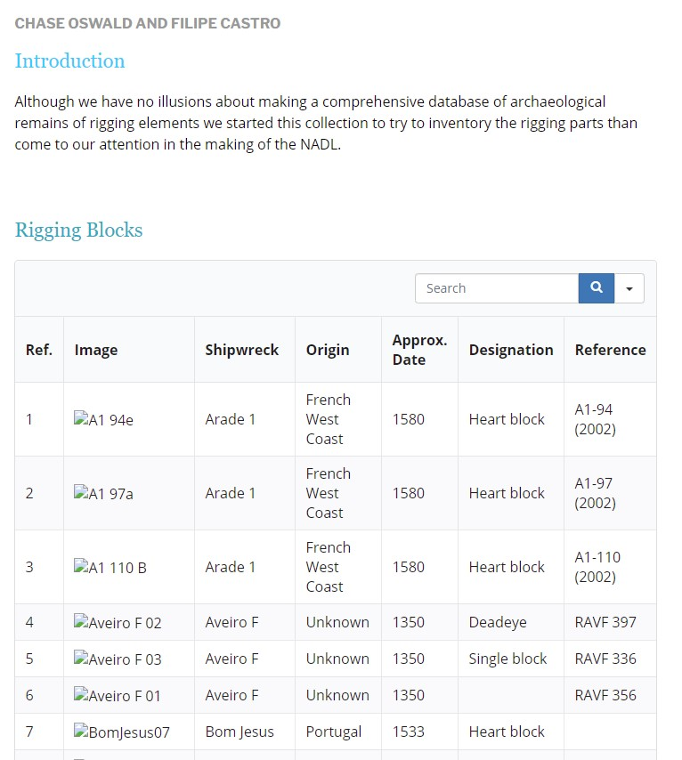
ERC – Datasets
Rigging Elements
Images – need to get them from literature
Table – Need to make it
There is a small table with images in NADL

Slide 9
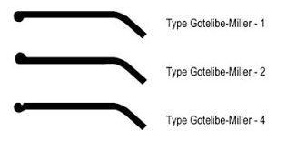
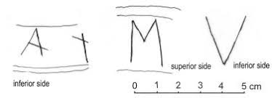
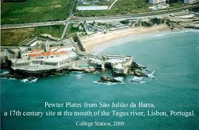
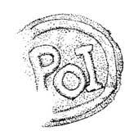
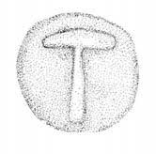
ERC – Datasets
Pewter
Images – need to get them from literature
Table – Need to make it
Tipology: Gotelibe-Miller
Pewter marks books, not digitized.

Slide 10
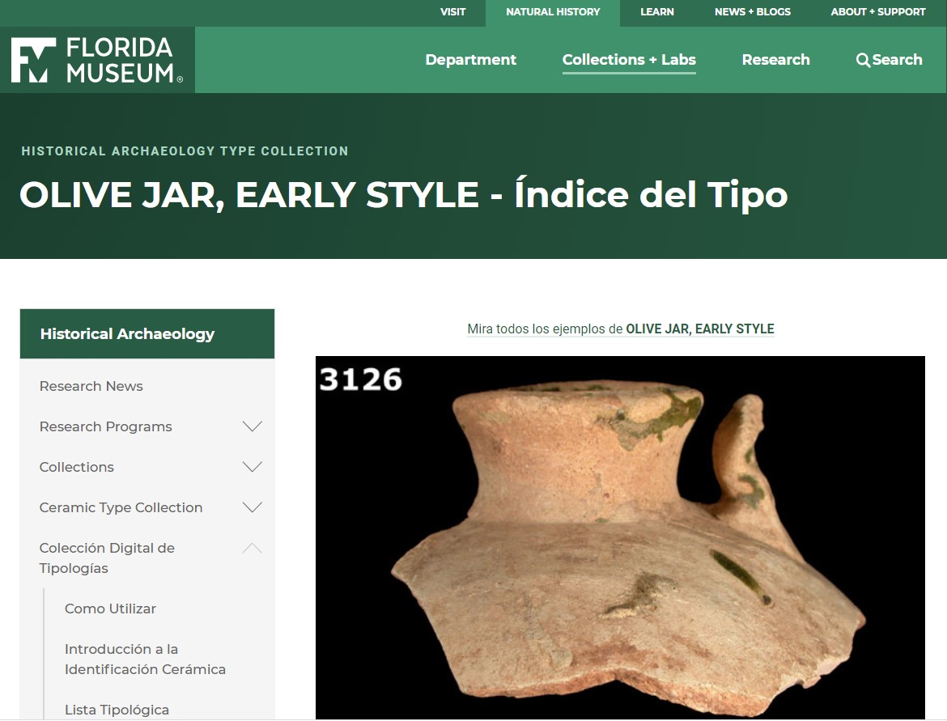
ERC – Datasets
Olive Jars
Images – need to get them from literature
Table – Need to make it
Tipology: all we have so far is Goggin…

Slide 11
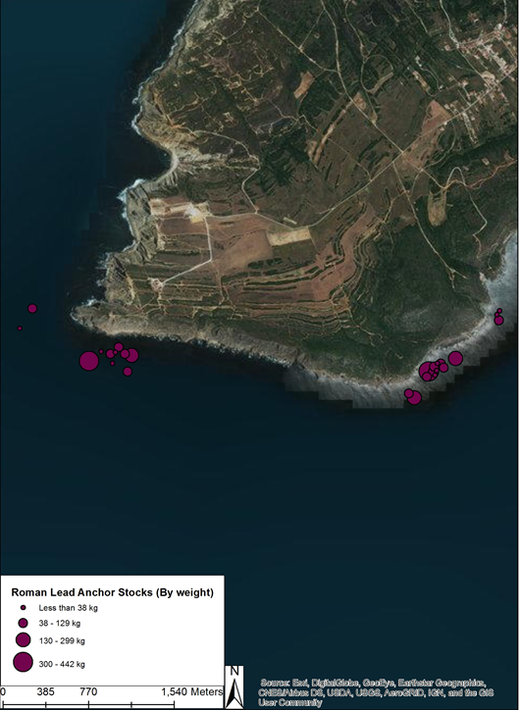
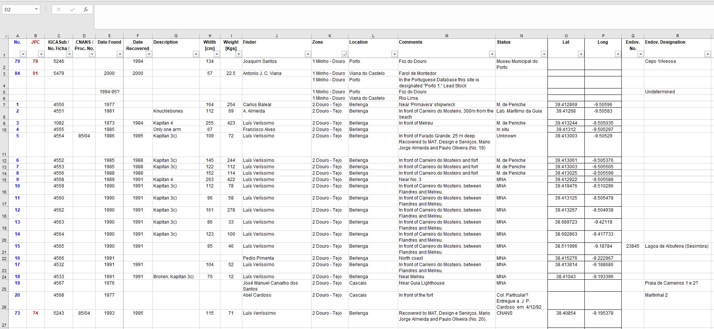
ERC – Datasets
Portuguese Lead Anchor Stocks
Images – we are missing about half
Table – needs to be cleaned

Slide 12
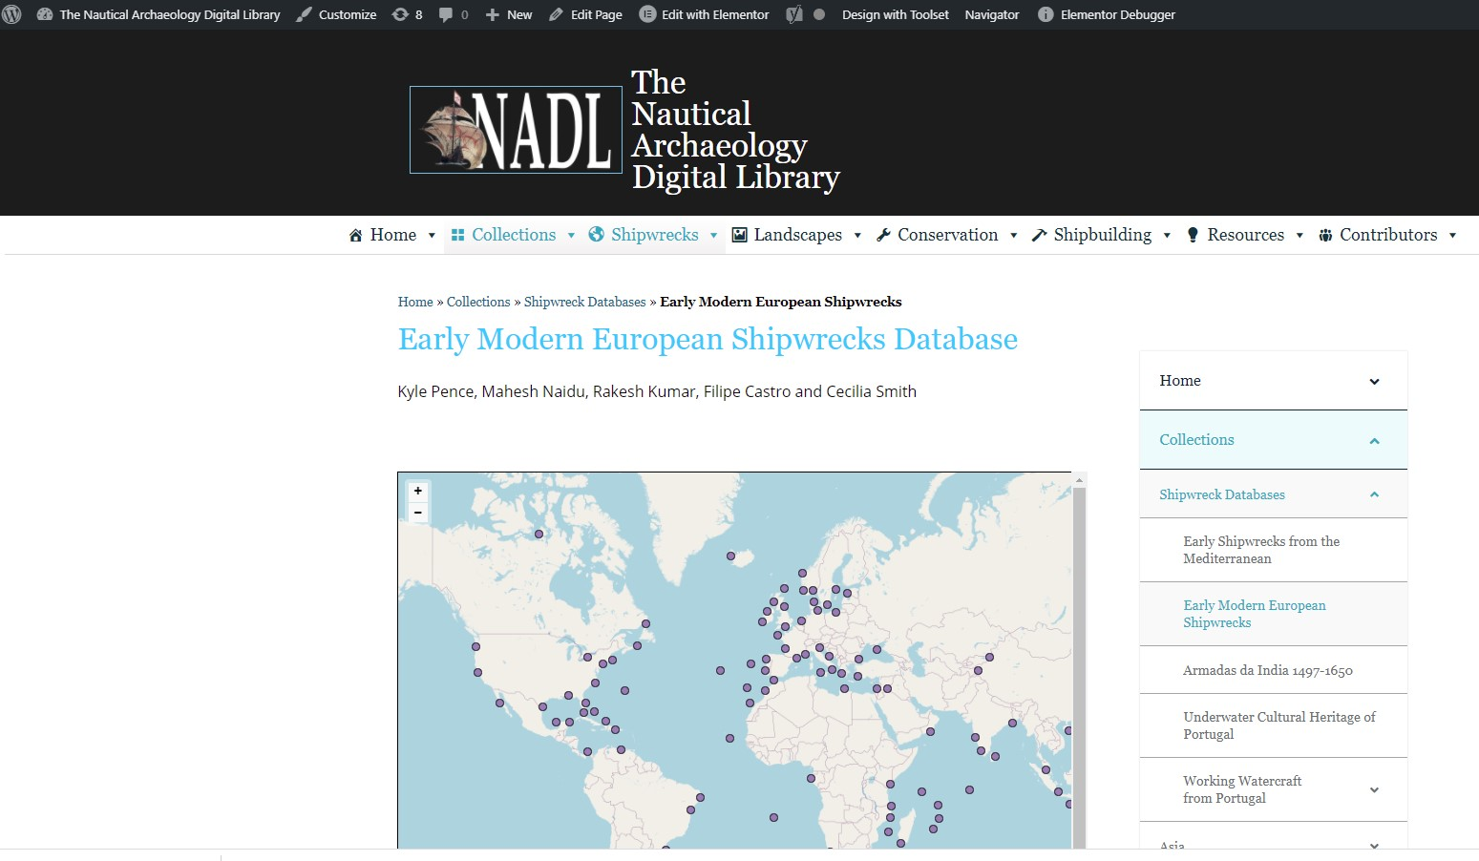
ERC – Datasets
Shipwrecks
Early Modern Shipwrecks table: needs to be completed with the ship’s scantlings, for instance;
We have lots of fiches of shipwrecks in NADL, and a template.
https://shiplib.org/index.php/collections/shipwreck-databases/early-modern-european-shipwrecks/

Slide 13
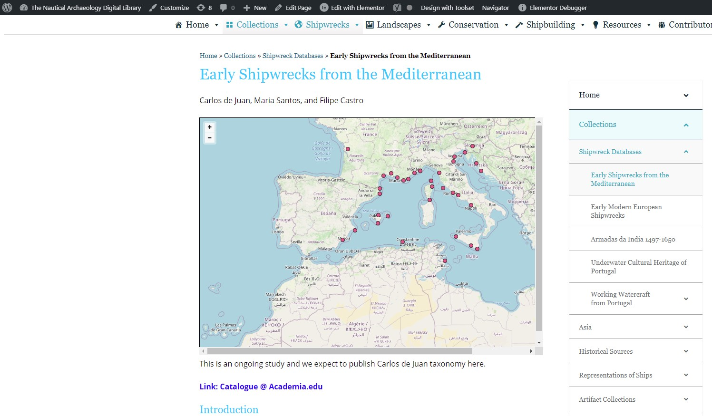
ERC – Datasets
Shipwrecks
b) Ancient Shipwrecks table: needs to be completed with the ship’s scantlings, for instance;
https://shiplib.org/index.php/collections/shipwreck-databases/early-shipwrecks-from-the-mediterranean/

Slide 14
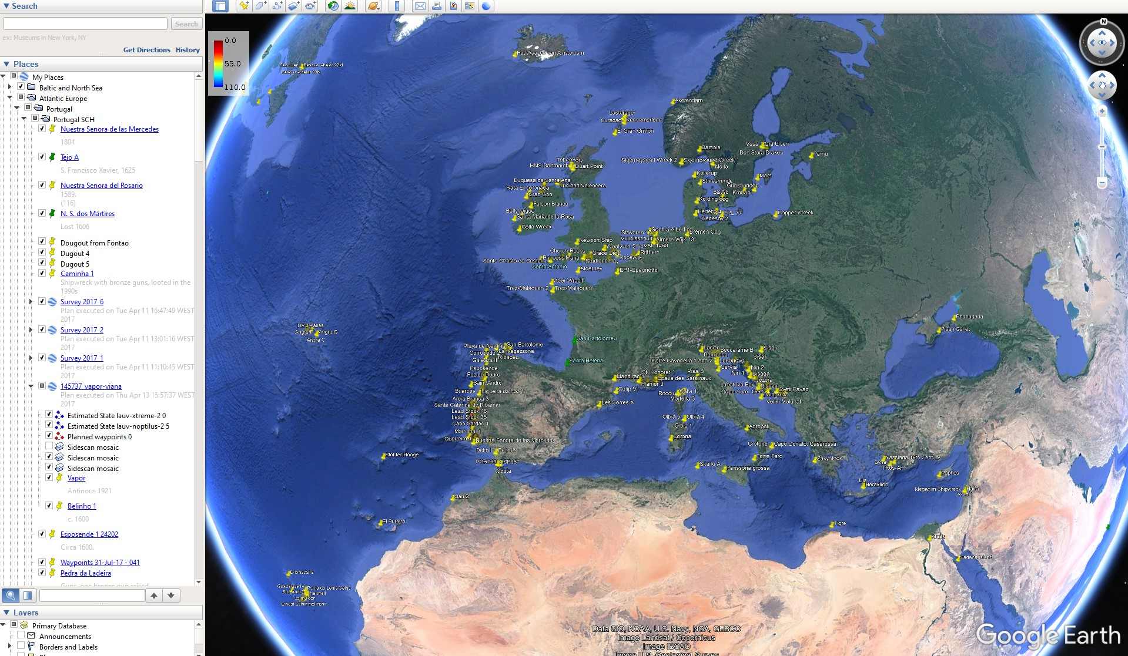
ERC – Datasets
Shipwrecks
c) All my .kmz files –not synchronized with the spreadsheets, but almost;

Slide 15
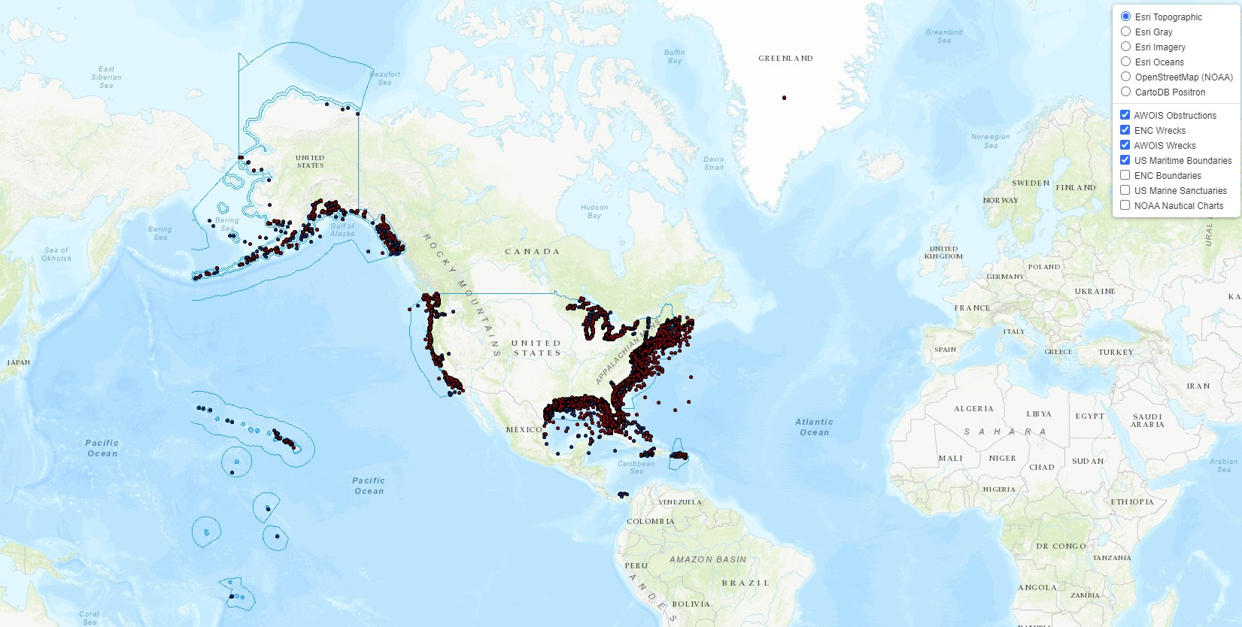
ERC – Datasets
Shipwrecks
d) NOAA GIS database – a good model from which we could perhaps take the template;

Slide 16
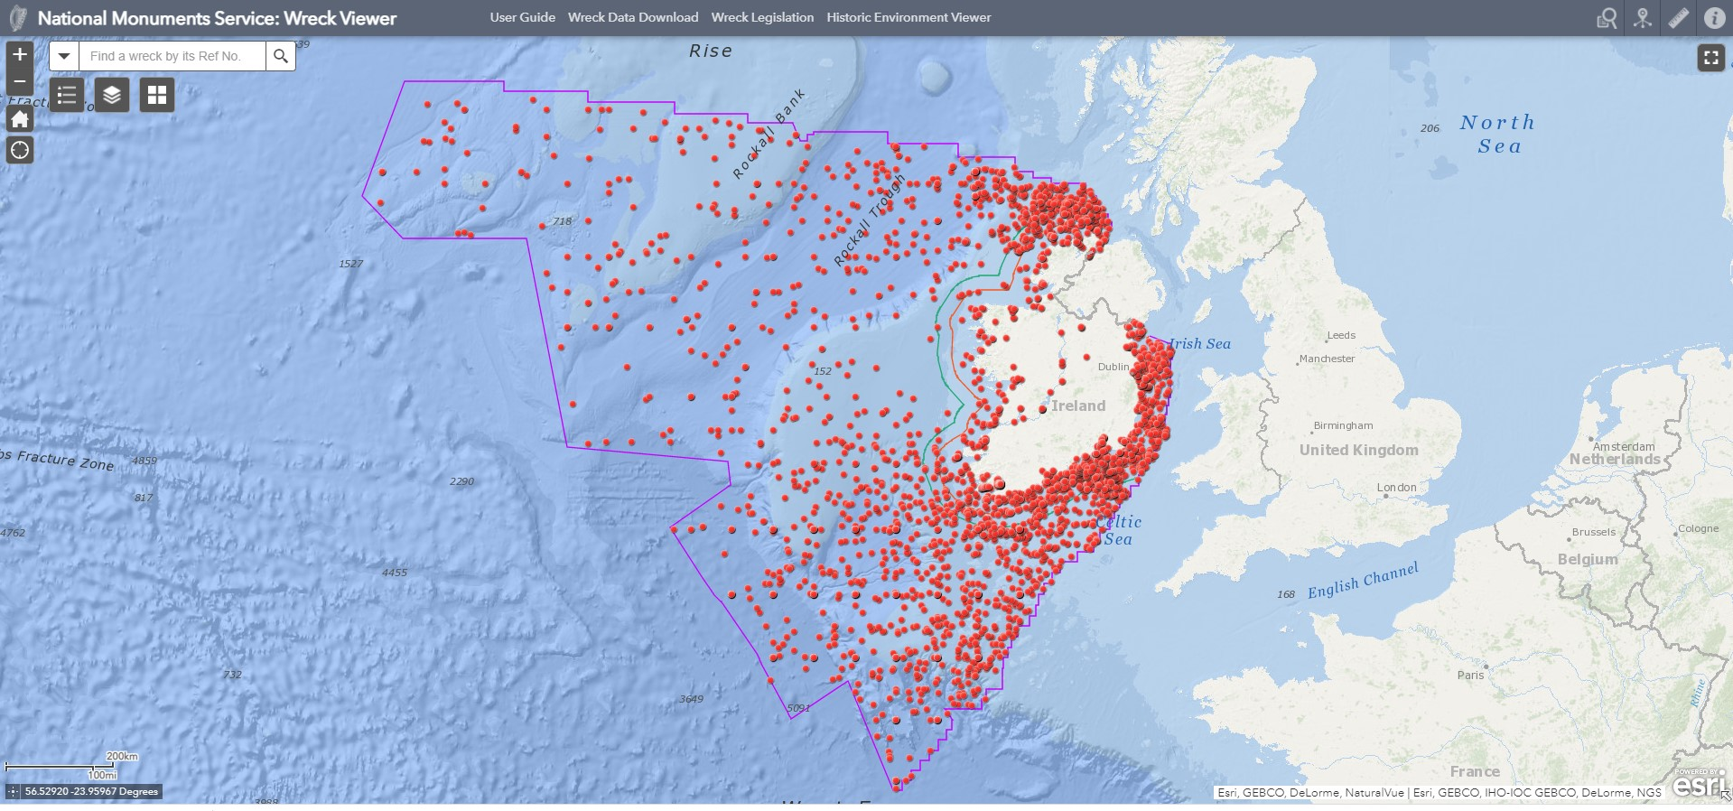
ERC – Datasets
Shipwrecks
e) Irish GIS database

Slide 17
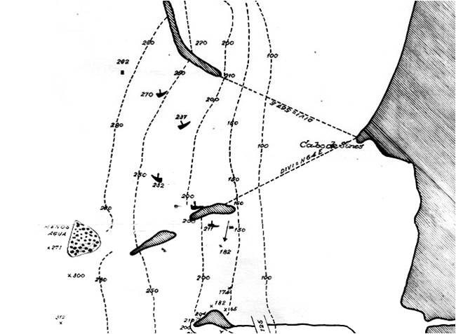
ERC – Datasets
Shipwrecks
Adolfo’s GIS database
Alex’ data…

Slide 18
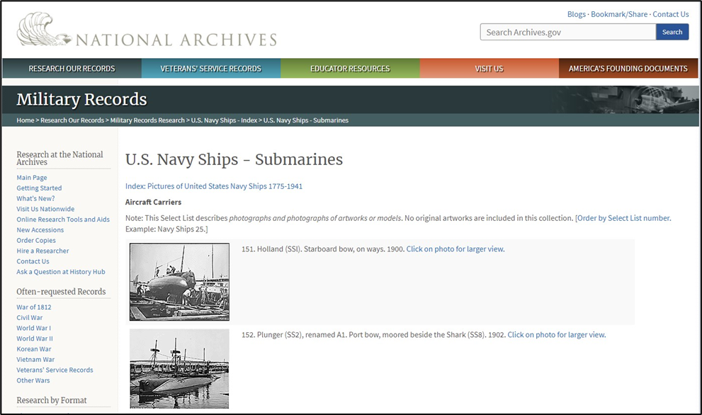
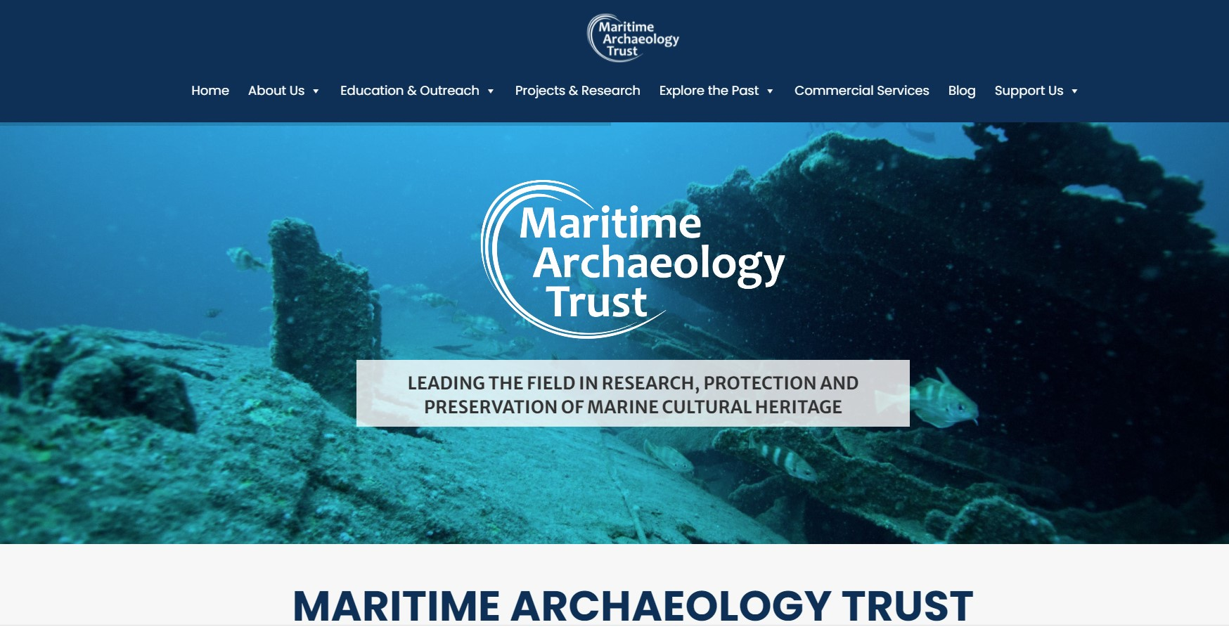
ERC – Datasets
Shipwrecks
g) Other databases… submarines, WWII, the databases from Gary Momber…

Slide 19
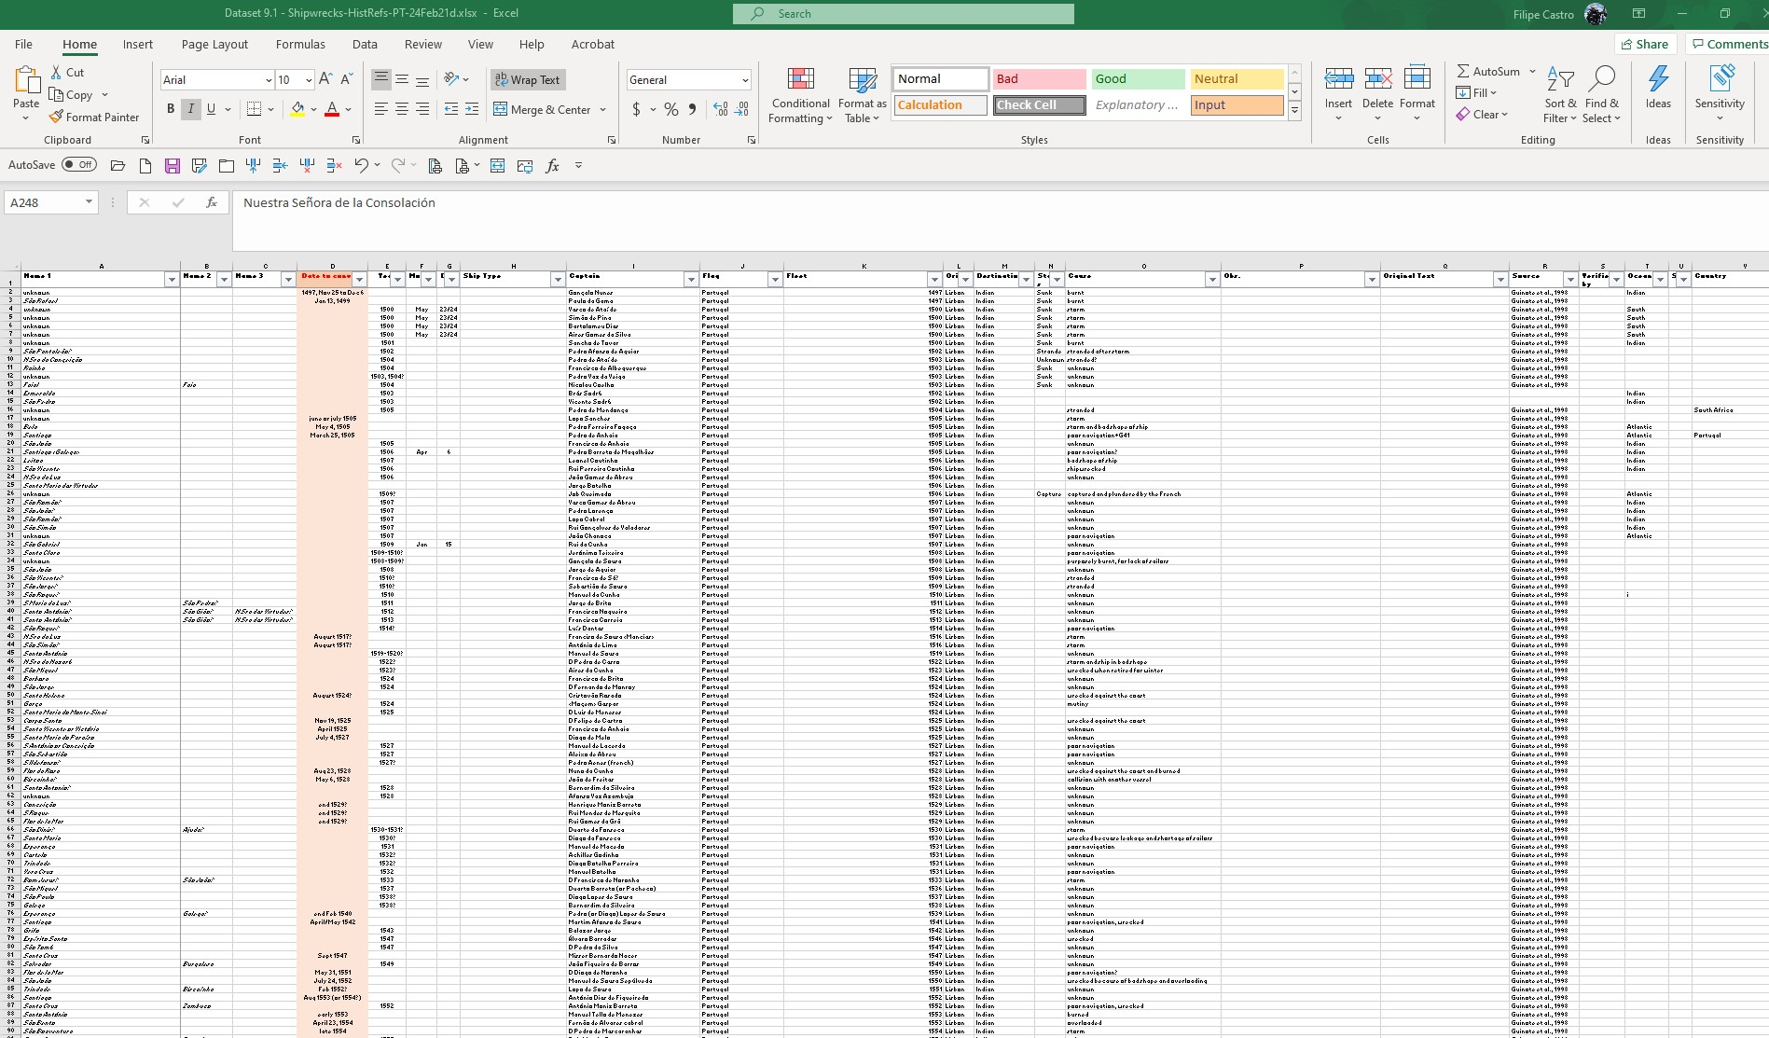
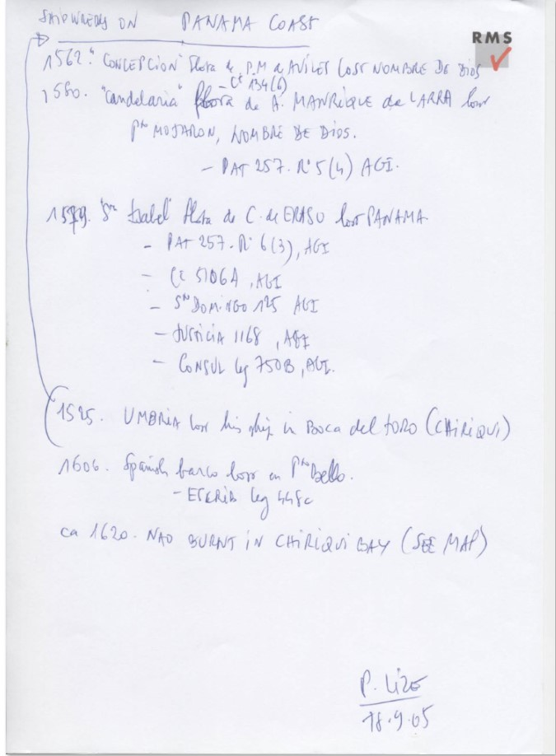
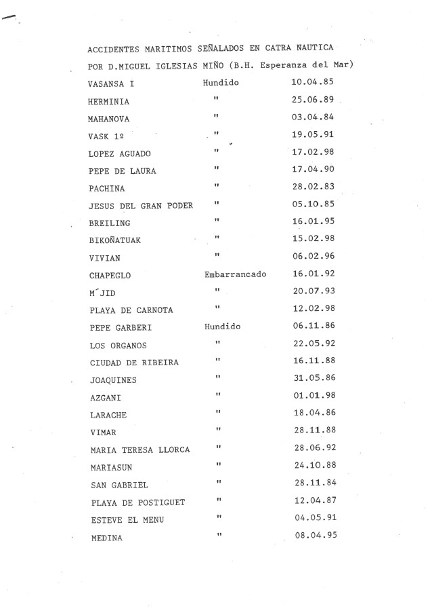
ERC – Datasets
Shipwrecks
h) Historical references databases: I have lots in different formats, and they should be entered in a spreadsheet.

Slide 20
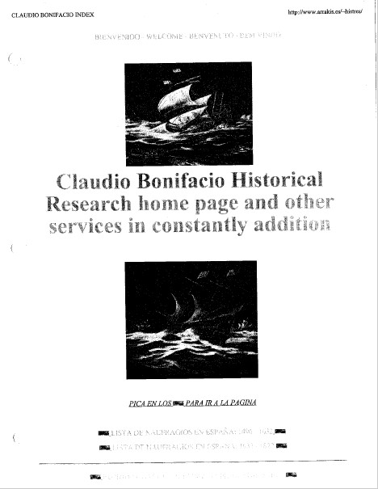
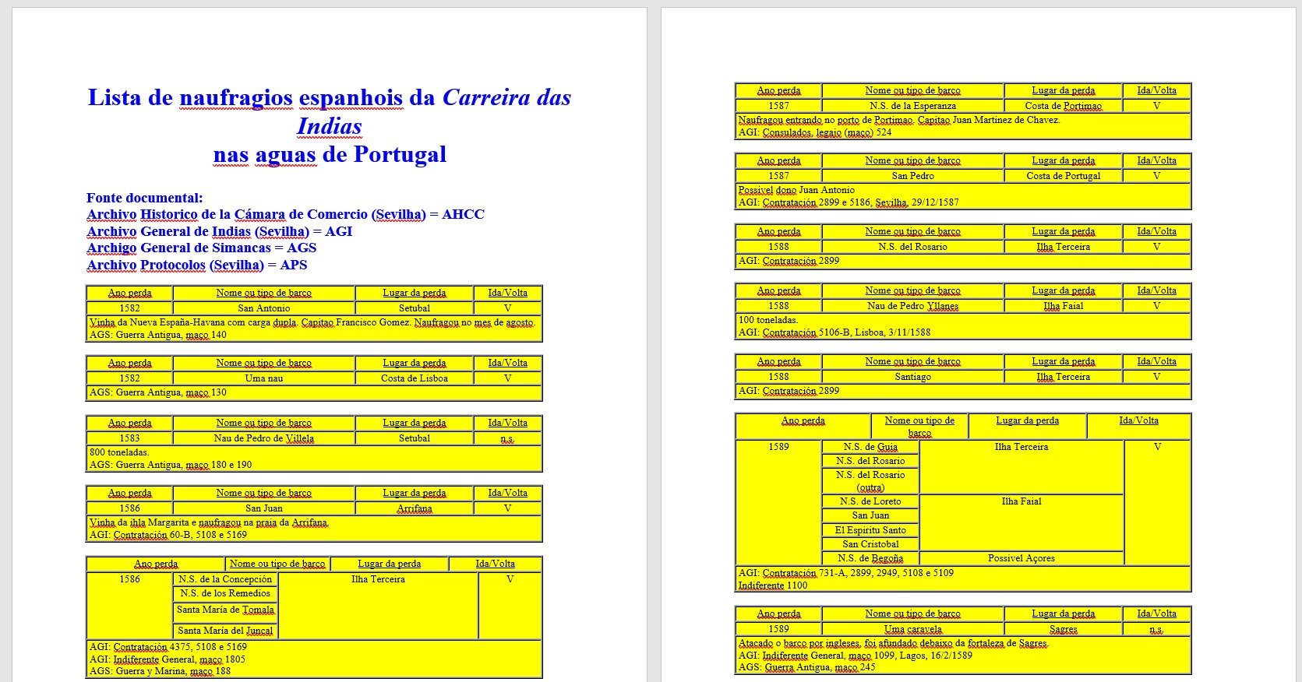
ERC – Datasets
Shipwrecks
h) Historical references databases: Some are not completely reliable and need to be entered as such.

Slide 21
ERC – Datasets
Shipwrecks
h) Historical references databases: The Lizé archive (CNANS) needs to be entered.
We should ask for money to hire students to enter data

Slide 22
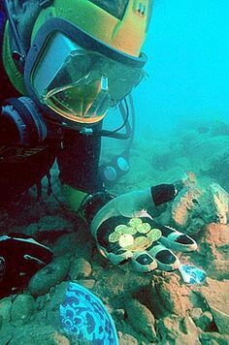
ERC – Datasets
Treasure Hunting
We should have a database of ships destroyed by looters and treasure hunters, and link Ole Varmer’s page and NADL’s ethics texts.

Slide 23
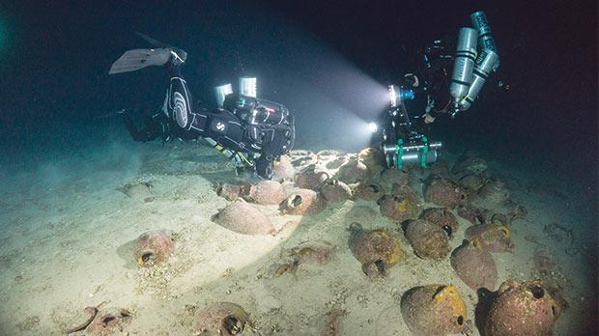
ERC – Datasets
Xlendi
A set of data documenting the investigation and the recording of a shipwreck over the years.

